Slide 1
HAND WEB BROWSER
(CONTROLLING WEB BROWSER VIA DIFFERENT HAND GESTURES)
UNDER THE GUIDANCE OF: Mr.B.VEERENDRA.,M.Tech.,(Ph.D) HOD,Assoc.Prof | PRESENTED BY: G.RAJ KUMAR | (18JQ1A0537)
CSE Department.

Slide 2
CONTENTS
ABSTRACT
INTRODUCTION
EXISTING SYSTEM
PROPOSED SYSTEM
ALGORITHM
UML DIAGRAMS
SOURCE CODE
TEST CASES
OUTPUT SCREENS
CONCLUSION & FUTURE SCOPE

Slide 3
ABSTRACT
Gestures are major forms of human communication.
Primary goal of hand web browser is to create a system that can identify specific human gestures.
In this project i have implemented a real time gesture recognition by using OpenCV library.
Instead of typing the whole site name, the user would be able to open the site in new tab with just a hand gesture.

Slide 4
INTRODUCTION
The basic goal of hand web browser is to improve the interaction between users and computers.
Hand gestures can also be used as a tool of communication between computers and humans.
Hand gestures support us in our daily communication to convey messages clearly.
The vision based technology of hand gesture recognition is an important part of human computer interaction.

Slide 5
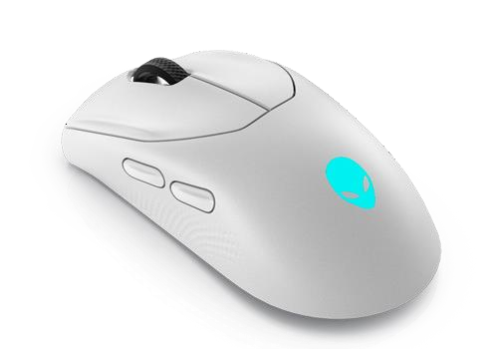
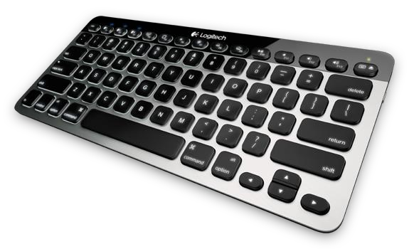
EXISTING SYSTEM
Mouse and Keyboard plays a significant role in human computer interaction.
A user needs to enter the site name by using keyboard, mouse, and also by speech recognition.
The input devices mouse , keyboard and joystick are still the most common interaction way.

Slide 6
PROPOSED SYSTEM
I plan to design a system by using image processing techniques and controlling the browser using hand gestures.
Following methods are used in Hand Gesture Recognition
1.Image acquisition:
An image gets captured from web camera which is connected to the laptop as an input.

Slide 7
2.Pre-processing:
Convert to grayscale: It is the process of converting an image from RGB to gray scale.
Gaussian filter: It is used to blur the image and reduce image noise.
Thresholding: It convert an image from gray scale image to binary image.

Slide 8
3.Hand Detection:
Contour: It is a process of identifying structural outlines of objects in an image ,which helps to identify the shape of object.
Extraction of input: After pre-processing on the input image hand detection is done.

Slide 9
STEP-BY-STEP PROCESS OF HAND WEB BROWSER
Webcam(input))
Hand gesture
Image processing
Hand gesture recognition
Operation to be performed
(output)

Slide 10
ALGORITHM
Otsu’s thresholding algorithm:
Otsu’s Method is used to automatically select a threshold value based on the shape of the histogram of the image.
Otsu’s method is an thresholding way for binarization in image processing.
It can find the optimal threshold value of the image by going through all possible threshold values (from 0 to 255).

Slide 11
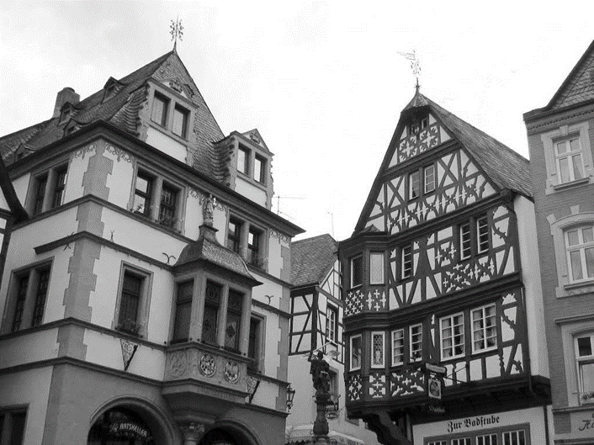
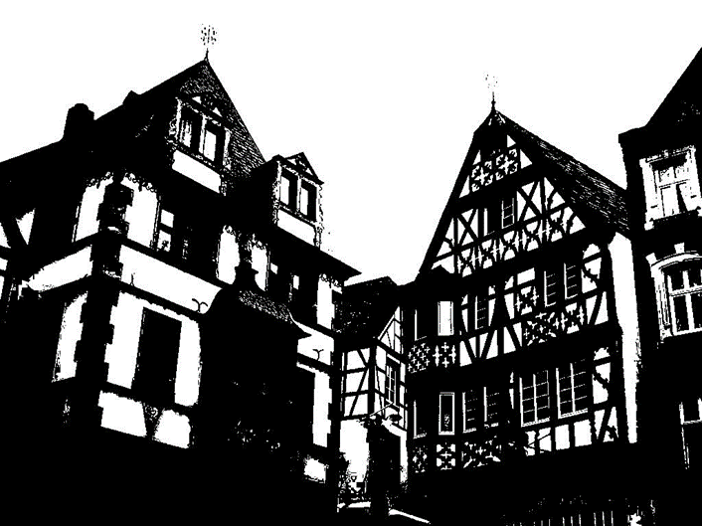
Gray scale image
Image thresholded using Otsu’s Algorithm

Slide 12
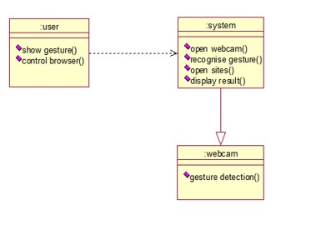
UML DIAGRAMS
CLASS DIAGRAM
Class Diagram consists of the classes and the object and the interaction between them. It mainly deals with interaction between classes in the system , their behaviour and properties of the system.

Slide 13
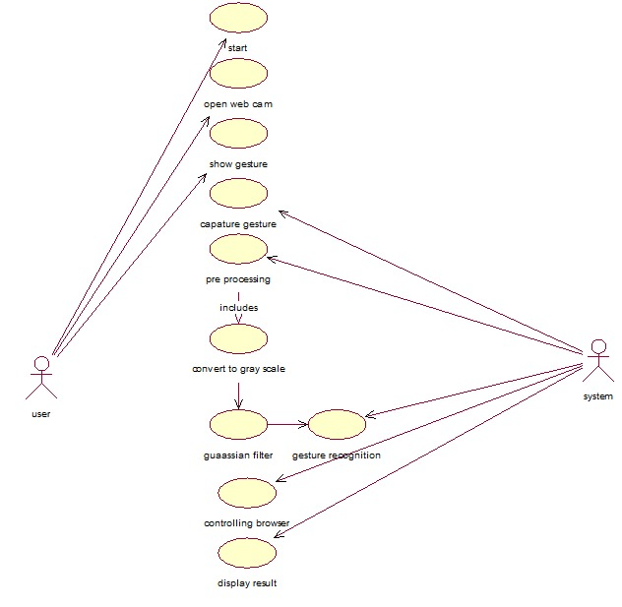
USE CASE DIAGRAM
Use case diagram consists of use cases and actors and show the interaction between them.

Slide 14
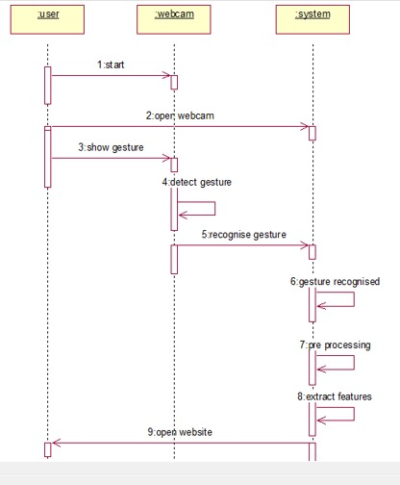
SEQUENCE DIAGRAM
It is an interaction diagram that emphasizes the time-ordering the messages.

Slide 15
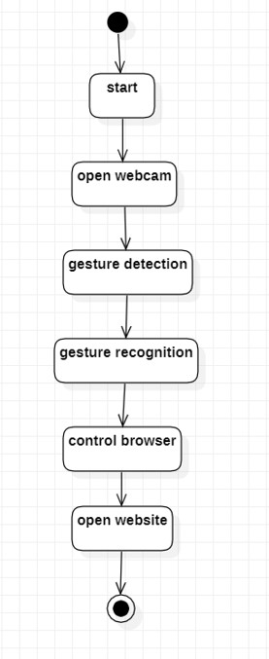
ACTIVITY DIAGRAM
Activity diagram shows the flow from activity to activity with in a system . It emphasizes the flow of control among objects.

Slide 16
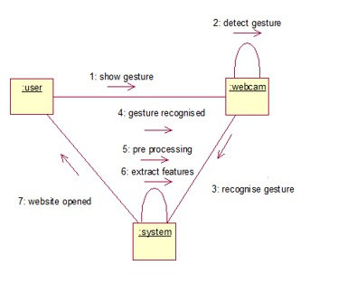
COLLABORATION DIAGRAM
It emphasizes the structural organisation of the objects that send and receive the messages.

Slide 17
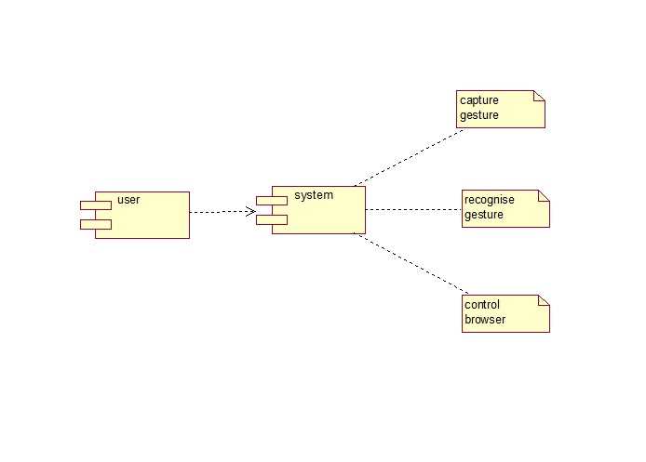
COMPONENT DIAGRAM
It shows the organization and dependency among the set of components.

Slide 18
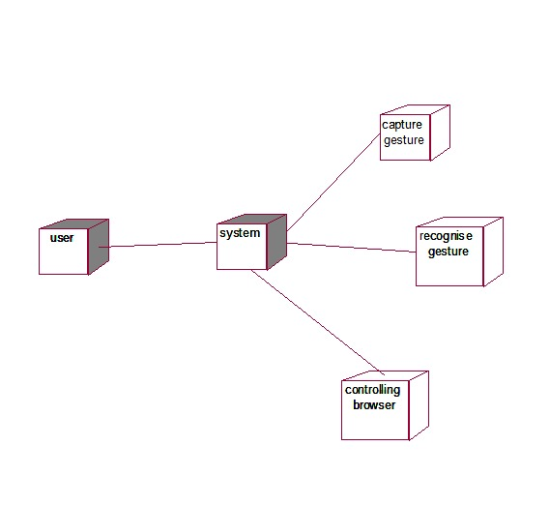
DEPLOYMENT DIAGRAM
It is a static deployment view . Deployment diagram shows the configuration of runtime processing nodes and the components.

Slide 19
SOURCE CODE
main.py:
import cv2
import numpy as np import math
import web browser as wb import os
print("Enter full website for")
print("\n2 fingers") fingers2 = input() print("\n3 fingers") fingers3 = input() print("\n4 fingers") fingers4 = input() tabs = 0
count = 0
cap = cv2.VideoCapture(0)

Slide 20
while (cap.isOpened()):
# read image
ret, img = cap.read()
# get hand data from the rectangle sub
window on the screen
cv2.rectangle(img, (400, 400), (100, 100), (0,
255, 0), 0) crop_img = img[100:400, 100:400]
# convert to grayscale
grey = cv2.cvtColor(crop_img, cv2.COLOR_BGR2GRAY)
# applying gaussian blur value = (35, 35)
blurred = cv2.GaussianBlur(grey, value, 0)

Slide 21
TEST CASES
SNO1 | TEST CASE NAME | TEST PROCEDURE | PRE CONDITION | EXPECTED RESULT | OUTPUT
1 | Checking threshold, gesture, contours | Recognise gesture | Web cam | Gesture, threshold , contours should be opened | Success
2 | 2 fingers gesture | Show two fingers | Google page | Facebook should be opened | Success
3 | 3 fingers gesture | Show three fingers | Google page | Youtube should be opened | Success
4 | 4 fingers gesture | Show four fingers | Google page | Twitter should be opened | Success

Slide 22
5 | Checking whether website is opened | Show four fingers | Facebook | Open twitter while in facebook | Success
6 | Closing web browser | Show five fingers | Google page | Browser should close | Success
7 | 1finger gesture | Show one finger | Google page | Should not open any tab | Success

Slide 23
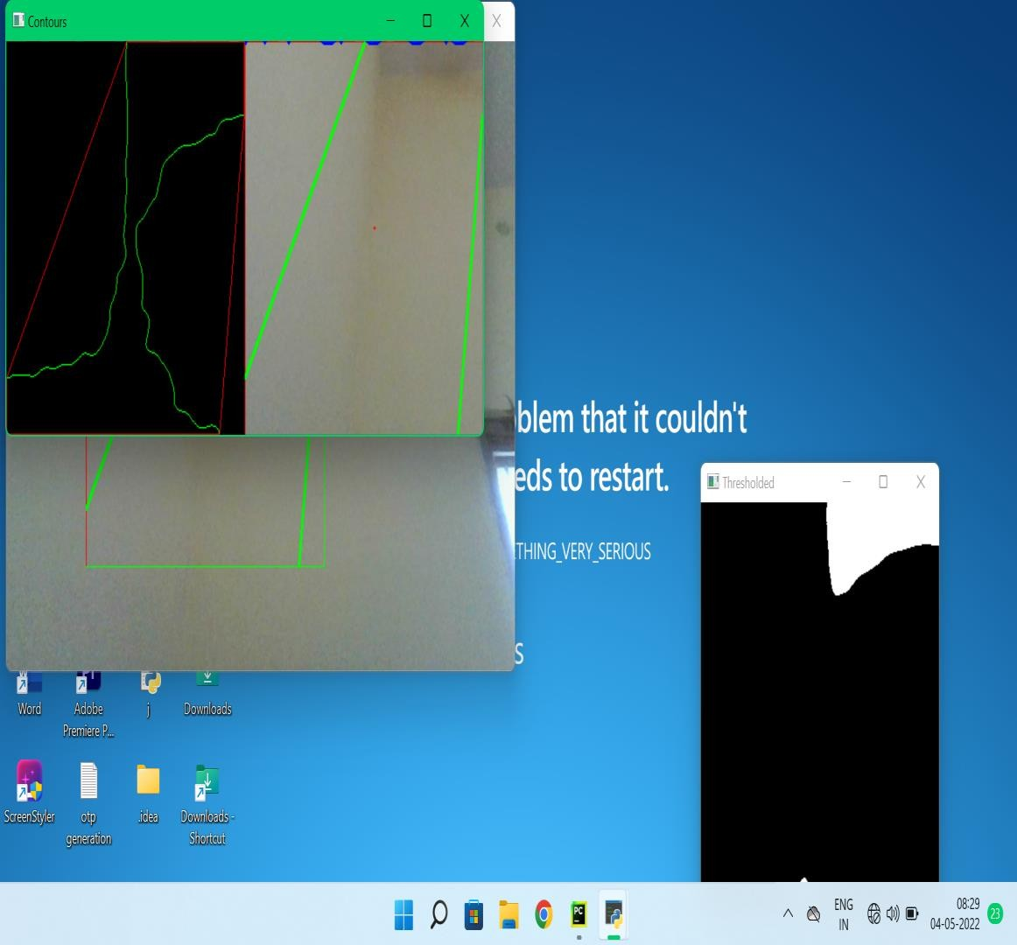
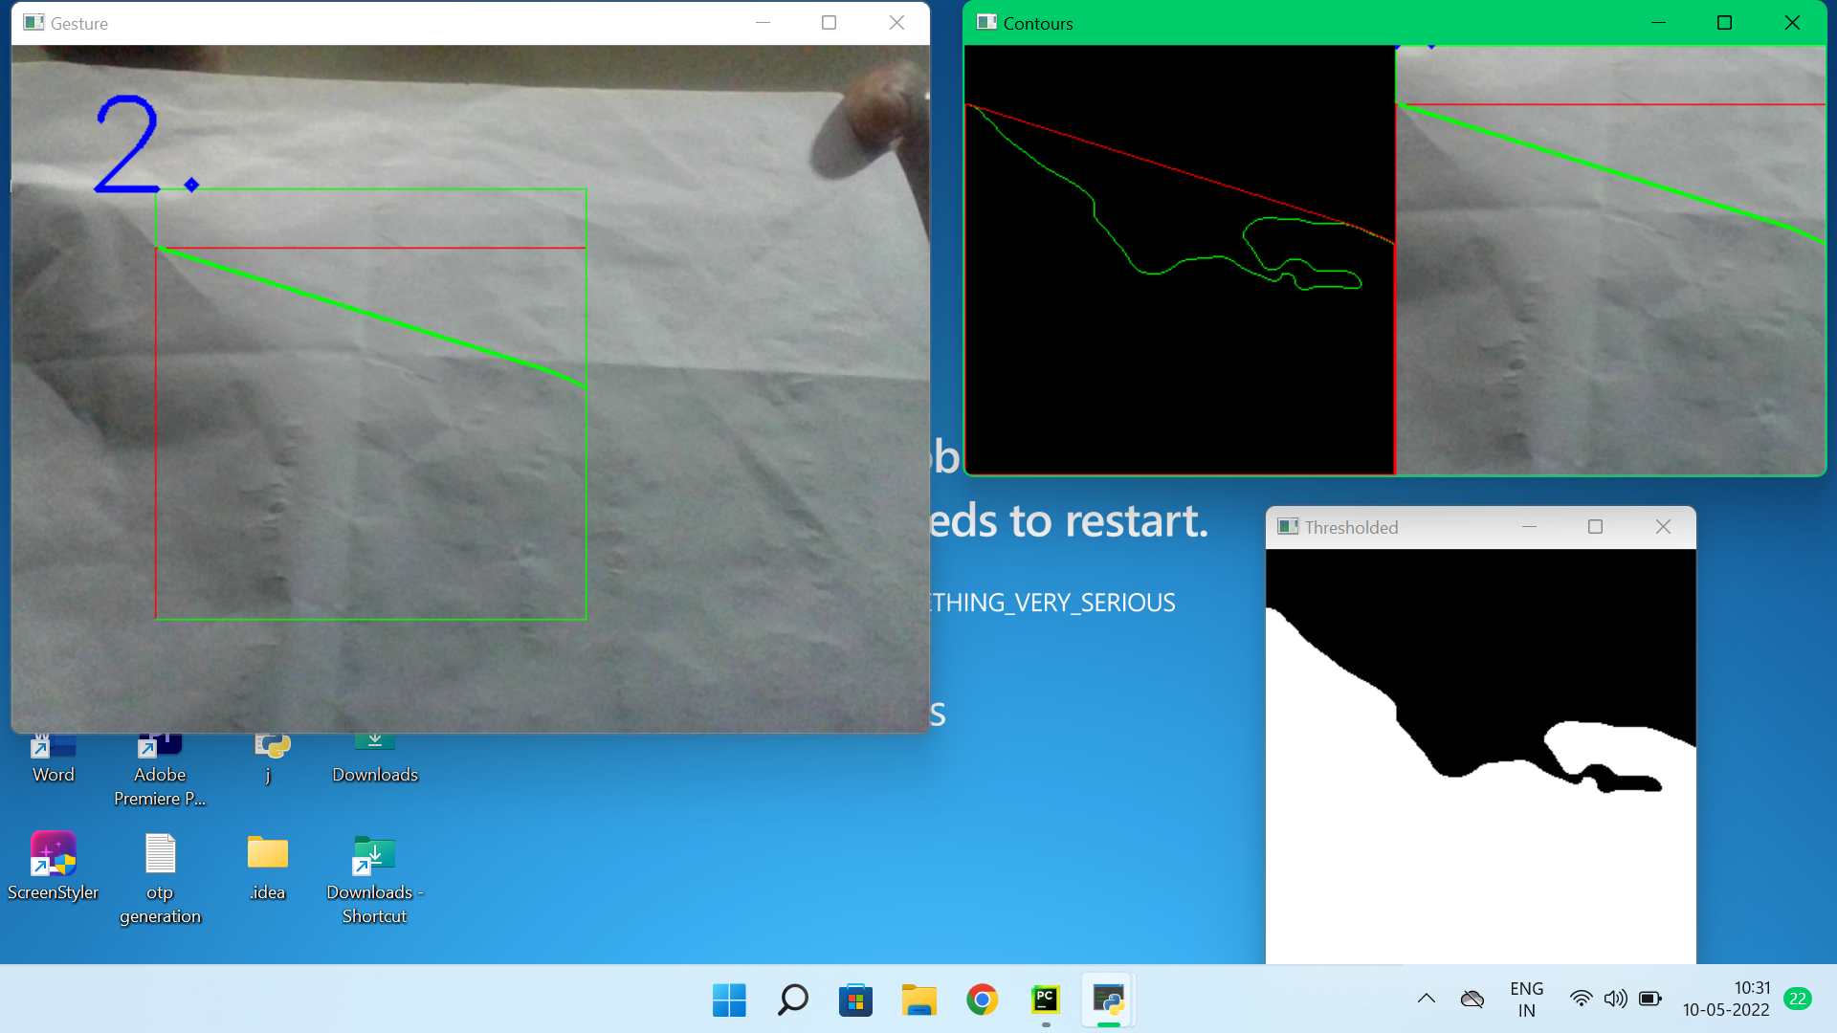

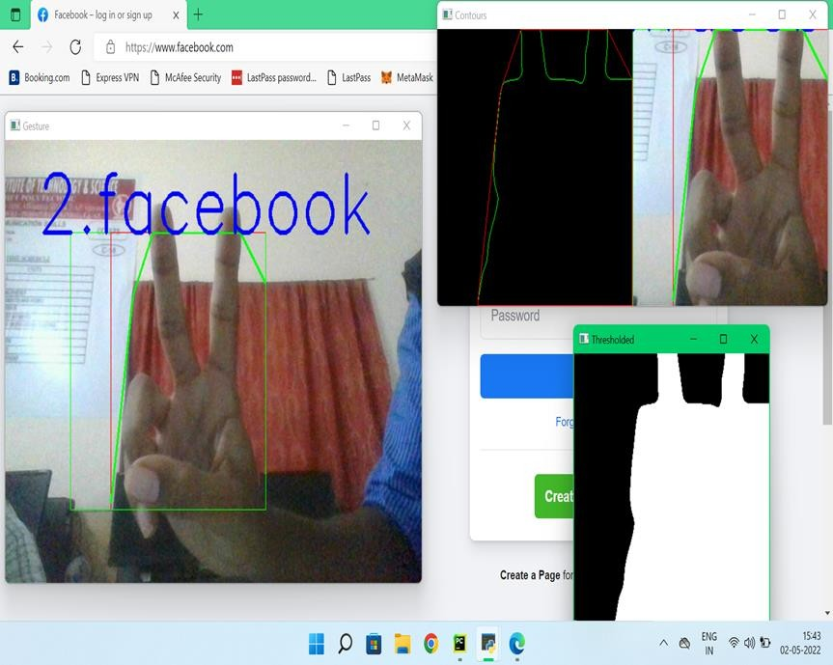
OUTPUT SCREENS
Checking threshold , gesture and contours
Showing two fingers to open Facebook

Slide 24
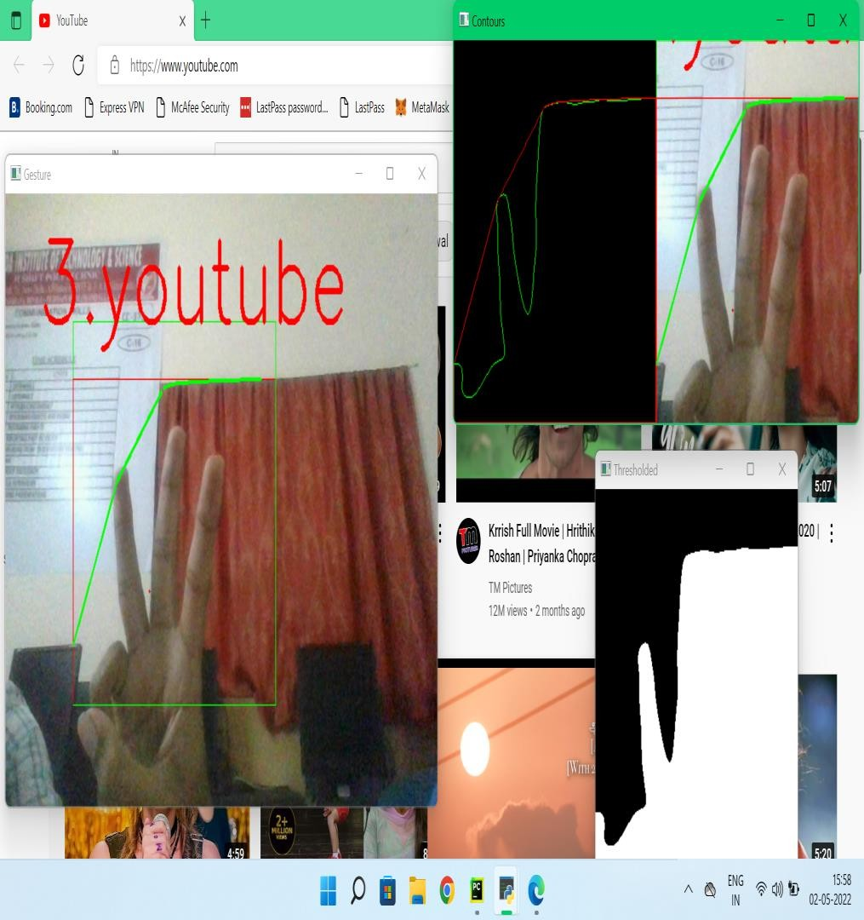
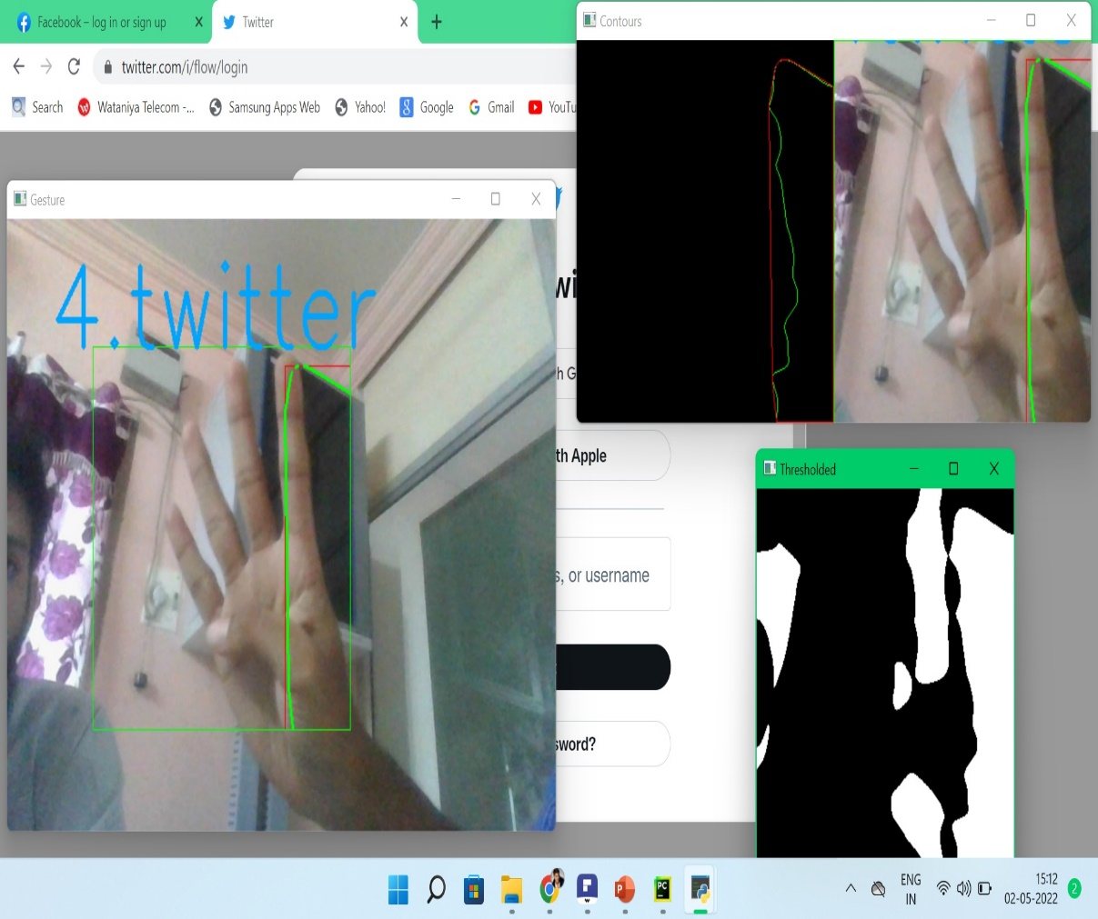
Showing three fingers to open Youtube
Showing four fingers to open Twitter

Slide 25

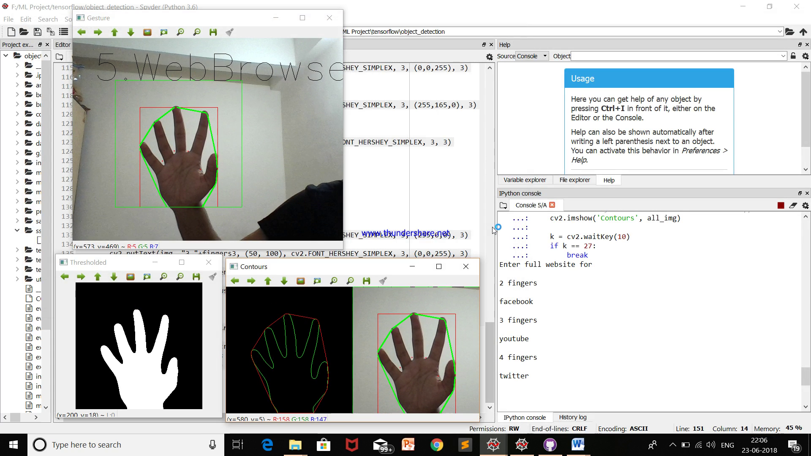
Open Twitter while in Facebook
Showing five fingers to close web browser

Slide 26
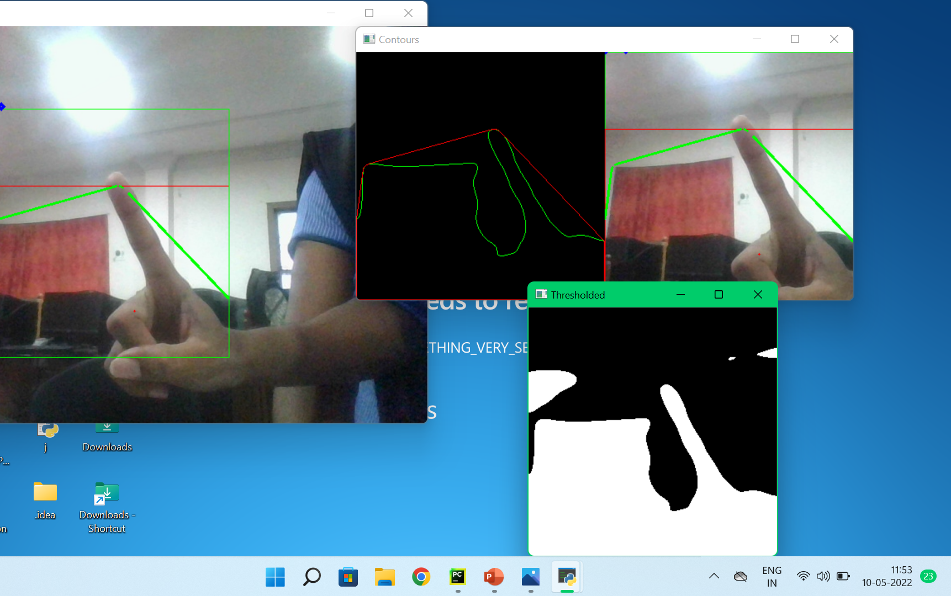
Showing 1 finger gesture

Slide 27
Conclusion
Users can use this technology to easily open the websites which they
want in the web browser .
Thus, a web browser which is controlled via hand gestures and is now implemented.
FUTURE SCOPE
Implement Gesture based games.
Implement the system to scroll up and down in the page using different hand gestures.
Implement gesture based passwords.

Slide 28


